Slide 1

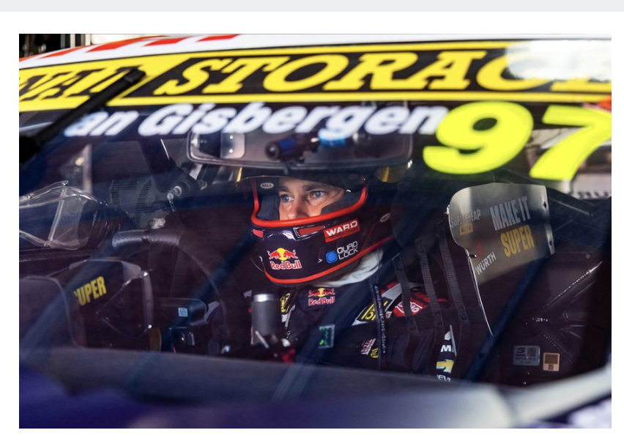

Slide 2

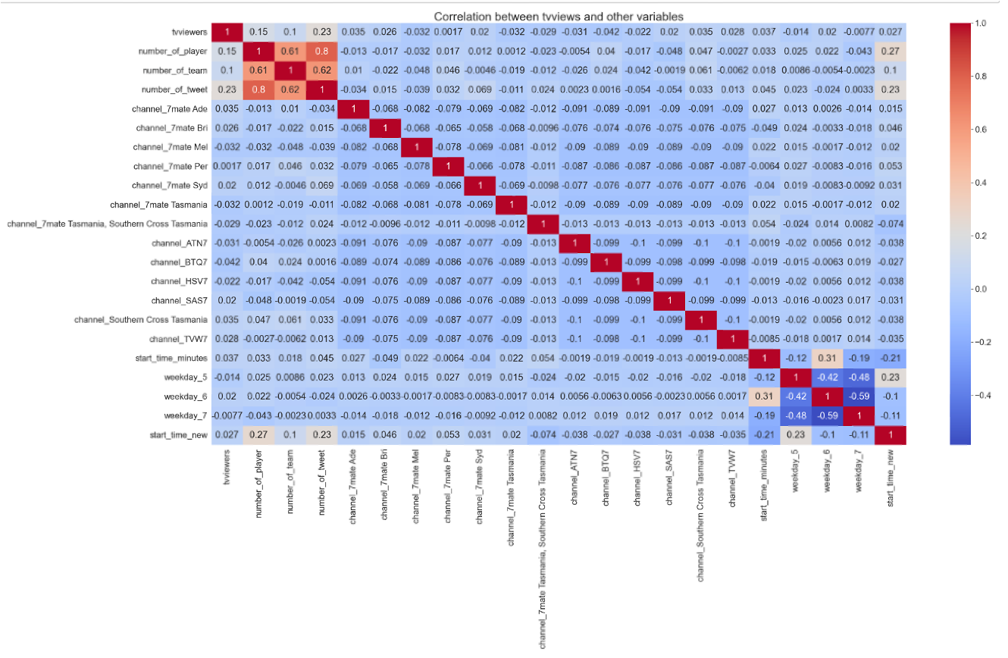

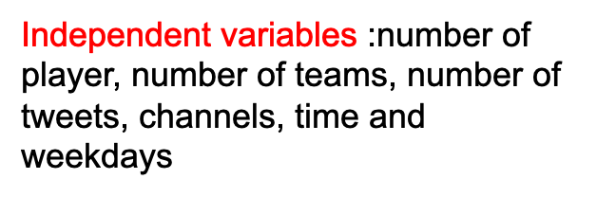
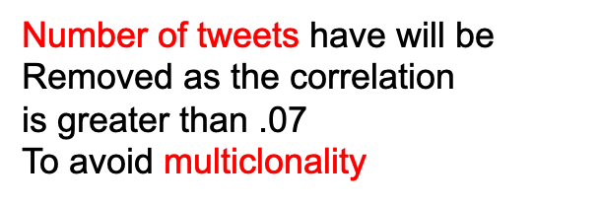

Slide 3
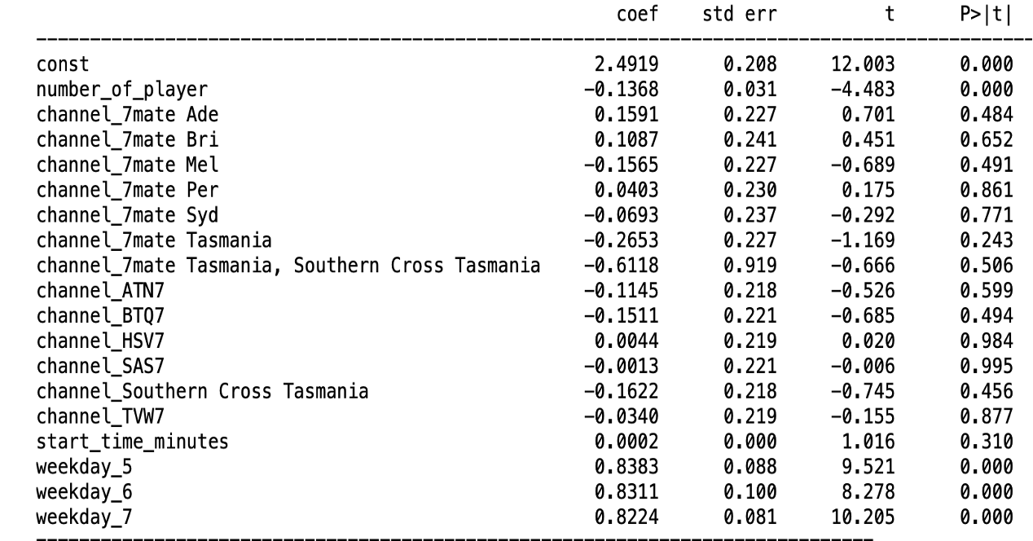

Slide 4
Q2: How does Supercars improve tweet engagement based on fans attitude?
Why Bathurst1000?
Iconic motorsport event held annually in Australia
One of the most prestigious and challenging touring car races in the world
The Bathurst 1000 is part of the Supercars Championship, formerly known as the V8 Supercars Championship.
Why event 11?
9619 comments among the total 13,522 comments, with 1592 negative samples and 4275 positive samples

Slide 5
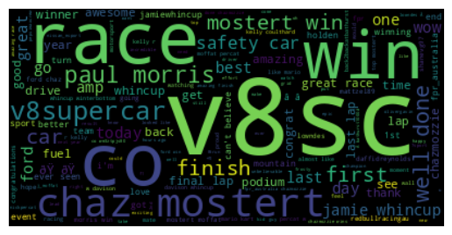
Positive Analysis

Slide 6
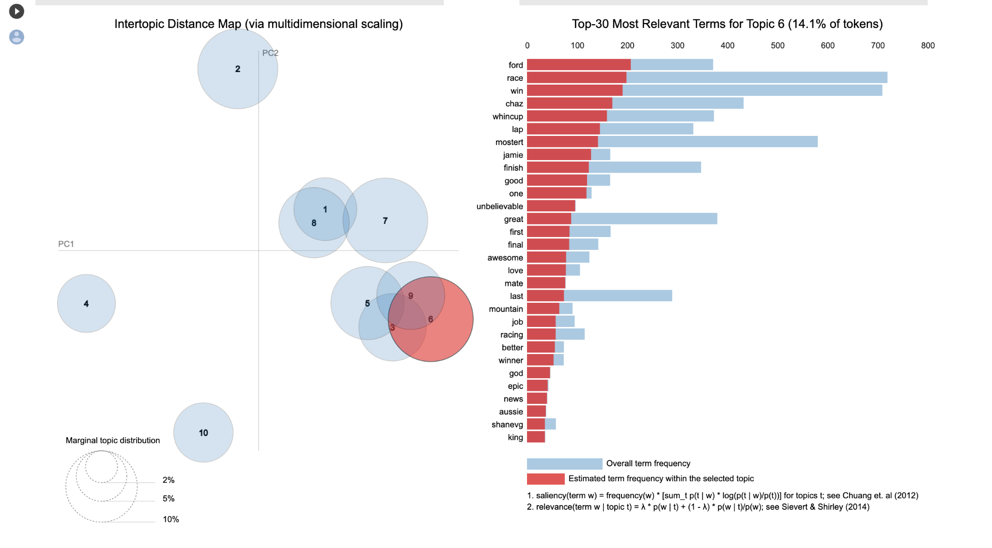
Positive analysis
Topic 6:
Congratulating on Ford Performance Racing Team, especially the team member Chaz Mostert winning on final lap on an incredible 2014 Bathurst 1000 for Ford as Jamie Whincup ran low on fuel

Slide 7
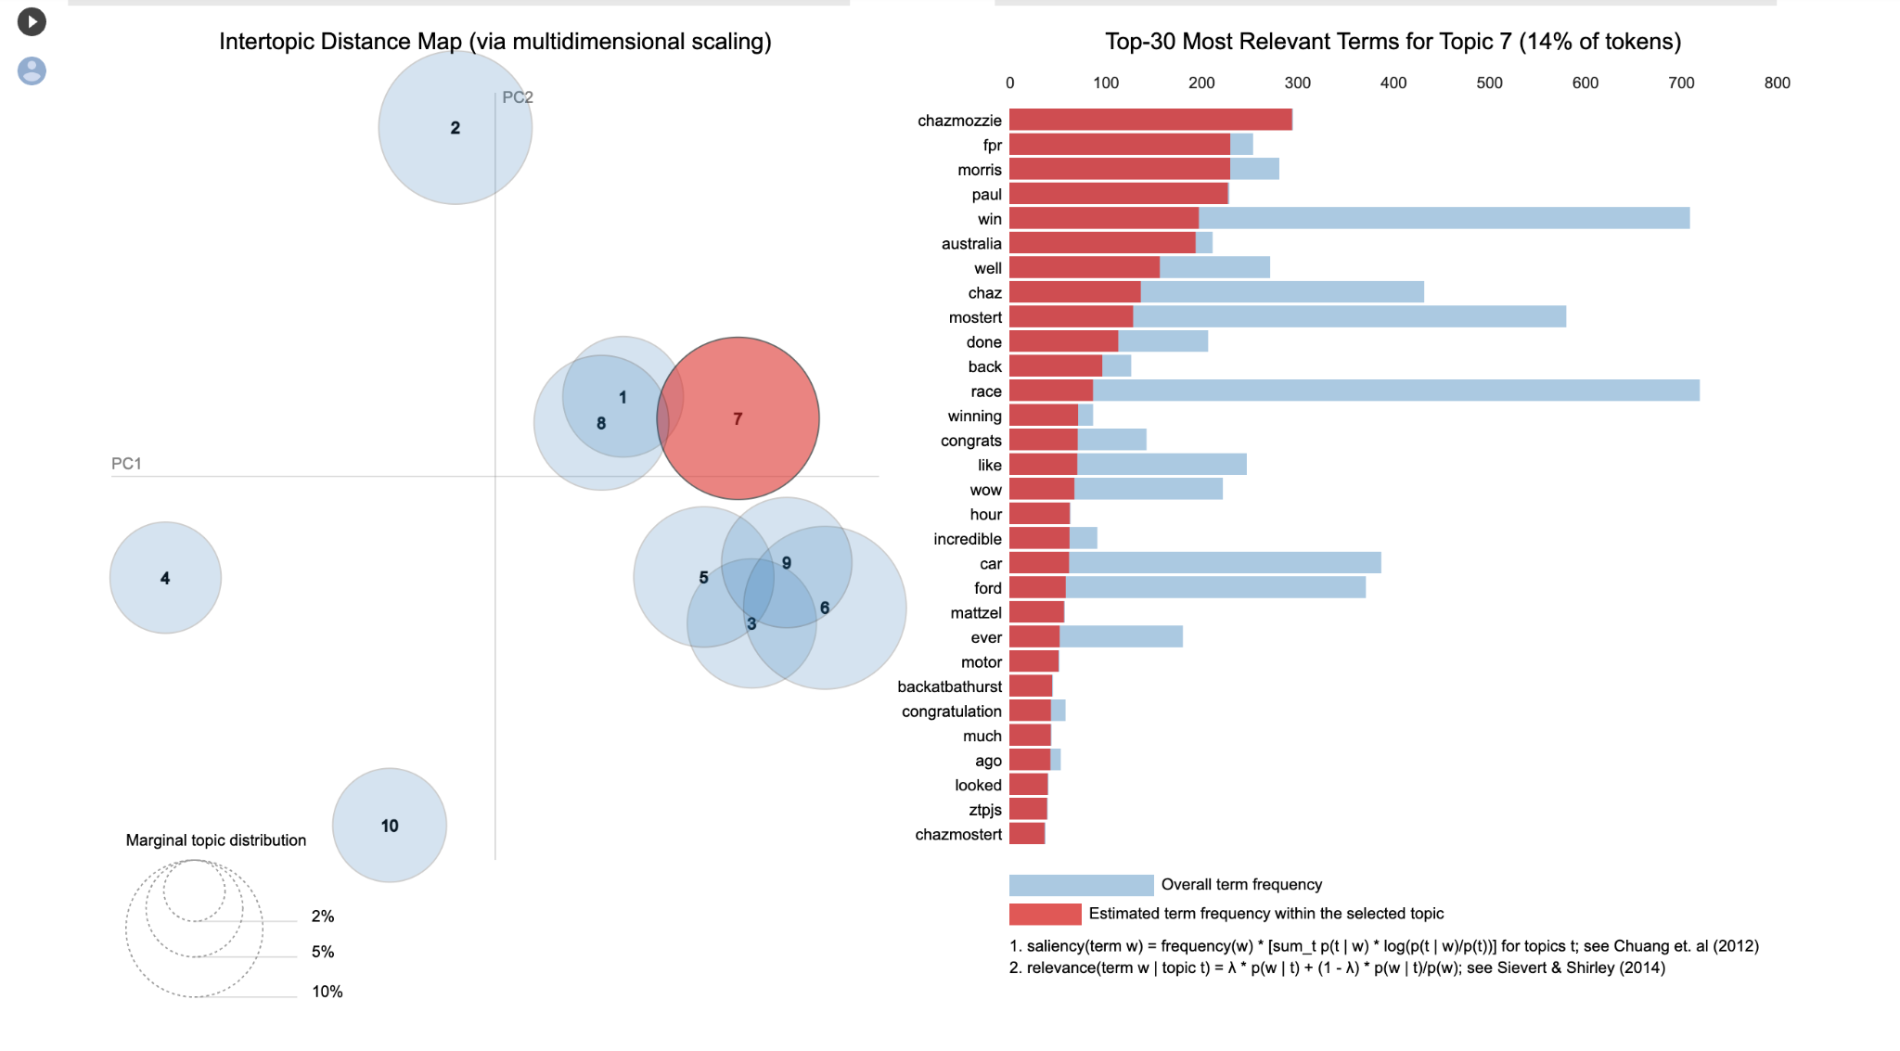
Positive Analysis
Topic 7:
Congratulating on Chaz Mostert and Paul Morris winning on final lap on an incredible 2014 Bathurst 1000 for Ford as Jamie Whincup ran low on fuel

Slide 8
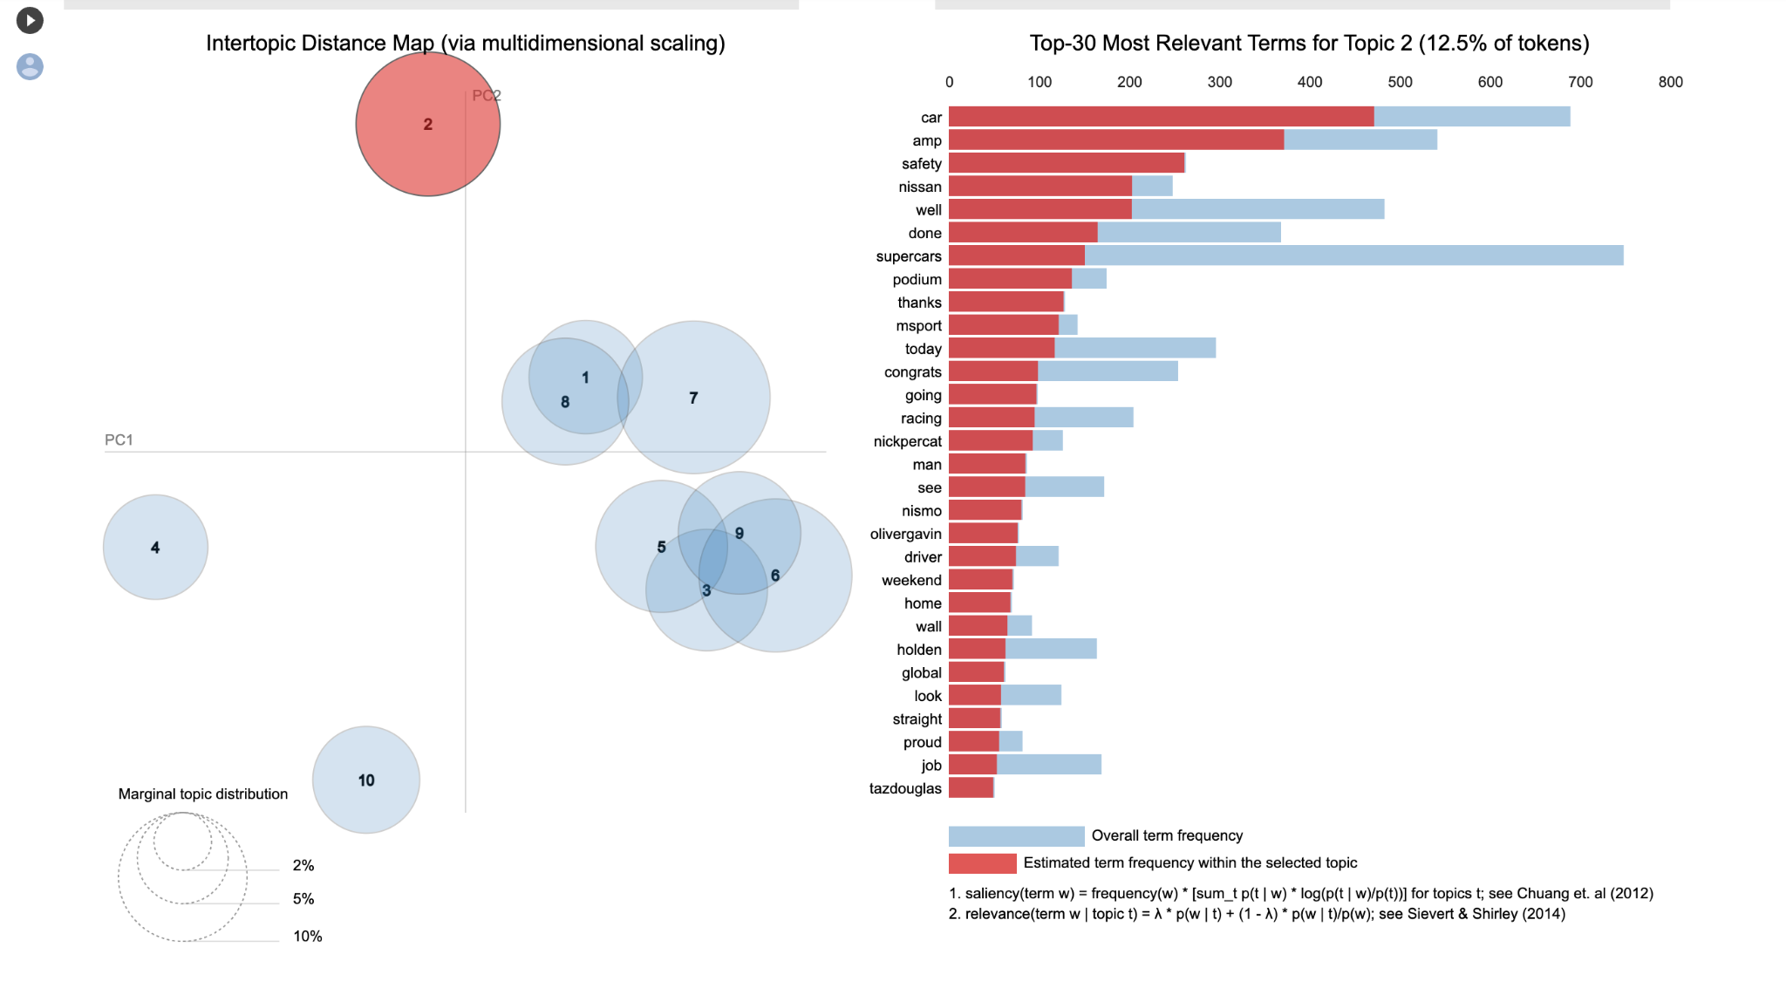
Positive Analysis
Topic 2： Congratulation on the Nissan Motosport team (James Moffat & Taz Douglas) winning the second place as well as (Nick Percat and Oliver Gavin) winning third place

Slide 9
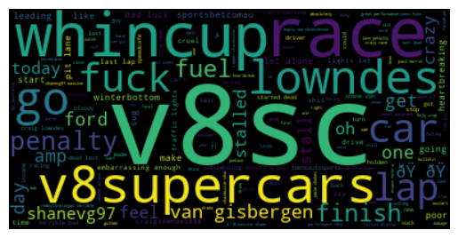
Negative sentiment Analysis - wordcloud

Slide 10
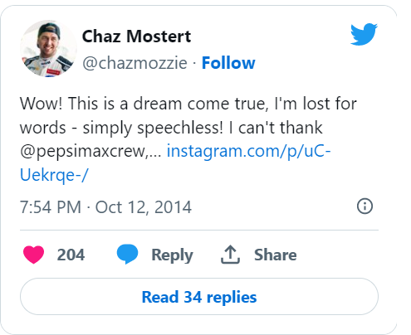
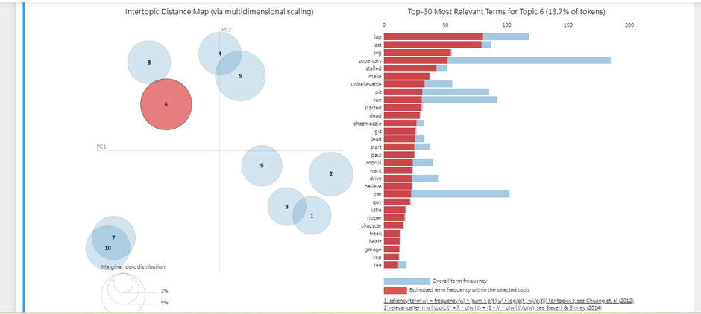

Negative sentiment Analysis- Topic 6

Slide 11
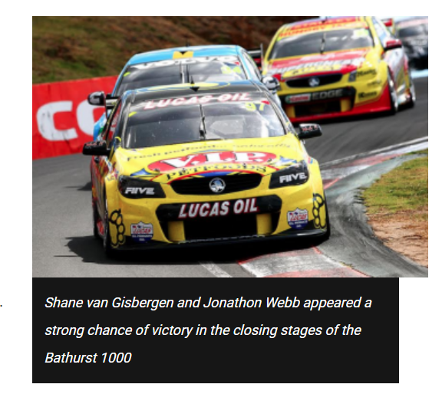
Negative sentiment Analysis - Topic 1
[('bad', 46.10683377720546),
('shanevg', 42.443158546698264),
('luck', 36.61797351415651),
('redbullracingau', 33.11169106054975),
('shame', 30.250483561504986),
('year', 26.453833733056676),
('teknoautosports', 26.333676998486187),
('bastard', 25.727612538179876),
('way', 25.506624178198077),
('terrible', 24.802613841847784)]
https://www.speedcafe.com/2014/10/13/van-gisbergen-gutted-critical-mistake/

Slide 12
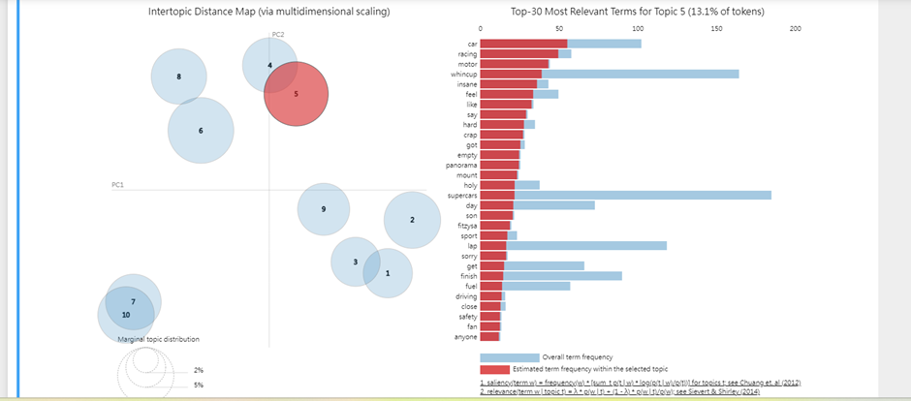
Negative sentiment Analysis- Topic 5

Slide 13
Recommedation
using the tweet poll function to support the teams and comment under the poll to increase audience engagement
put the winners’ name, story, pictures and videos on Supercar’s official account
focus on car safety
share more positive tweets

Slide 14
References
Autosports.(2014 Oct 12) . Bathurst 1000: Chaz Mostert/Paul Morris win from last for Ford. https://www.autosport.com/supercars/news/bathurst-1000-chaz-mostert-paul-morris-win-from-last-for-ford-5046355/5046355/
Bartholomaeus, S. (2014). Van Gisbergen ‘gutted’ after critical mistake. [online] Speedcafe. Available at: https://www.speedcafe.com/2014/10/13/van-gisbergen-gutted-critical-mistake/ [Accessed 14 May 2023].
Bartholomaeus, T.H.-S. (2014). No regrets for Whincup after defying orders. [online] Speedcafe. Available at: https://www.speedcafe.com/2014/10/12/regrets-whincup-defying-orders/ [Accessed 14 May 2023].
Maasdorp, J. ed., (2014). Chaz Mostert wins Bathurst 1000, pipping Jamie Whincup in final lap. [online] ABC NEWS. Available at: https://www.abc.net.au/news/2014-10-12/mostert-wins-bathurst-1000/5807842 [Accessed 14 May 2023].
Motosport. (2014 Oct 12). 2014 Bathurst 1000 race results. https://au.motorsport.com/v8supercars/news/2014-bathurst-1000-race-results/2837504/

Slide 15
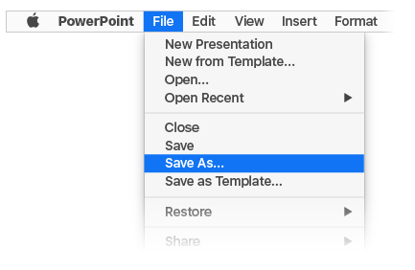
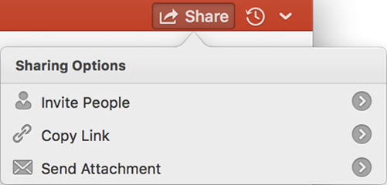
Designed for teamwork
With your document stored online, your group can work on it together at the same time.
How it works:
Select File > Save As to save your document in an online location, like OneDrive.
Select Share from above the ribbon.
Invite people or send a link so they can edit with you.

Slide 16
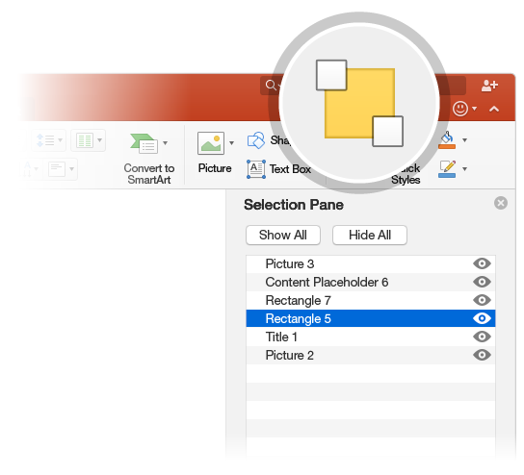

Get organized with the selection pane
The Selection Pane is a great tool to organize and manage the objects on a slide, such as images, shapes, and text boxes. The Selection Pane is a subscription-only feature. If you have an Office 365 subscription, you can try it yourself:
Try it:
Go to the Home tab, select Arrange > Selection Pane.
Try renaming an object: Double-click the name “Large grey rectangle” in the Selection Pane and type a new name.
Try changing the order of objects: In the Selection Pane, drag and drop the large grey rectangle so it’s at the top.
To toggle visibility of objects in the Selection Pane, click Show/Hide checkbox.

Slide 17

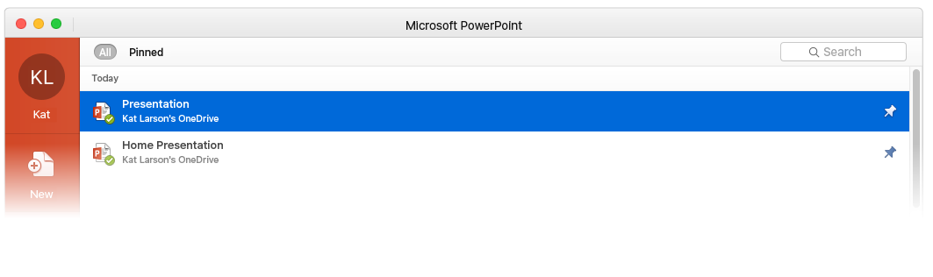

Pick up where you left off
When you sign in to Office 365, your documents go with you wherever you are. Signing in connects Office to you and to the cloud.
Whenever you launch a program, you’ll see the documents you recently opened on any of your devices.
Got a favorite presentation? Pin it to that first screen you see when you launch an Office program. It remains pinned even when you sign in to Office on another computer.
PowerPoint keeps track of where you left off. The next time you open a presentation, PowerPoint invites you to jump directly to where you were last reading or editing.

Slide 18

Notes:
In Slide Show mode, select the arrows to visit links.

